Slide 1
Lesson 3 –Past Perfect
Module 2 – Grammar Study 2

Slide 2
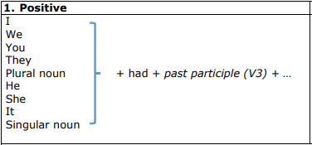
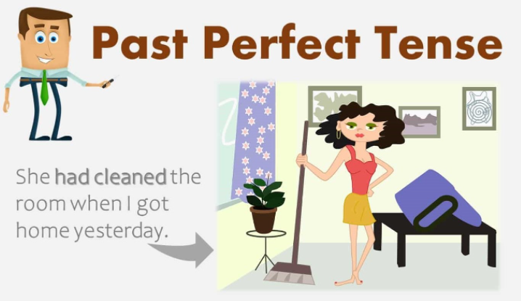
Present Perfect( had V3) Ex: We had studied very hard. Ex: She had met him before. Ex: Sona had wanted to see the movie.

Slide 3
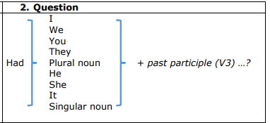
Ex: Had we studied hard before the exam?
Ex: Had Sina wanted to see the movie?
Ex: Had the plane left by 10?

Slide 4
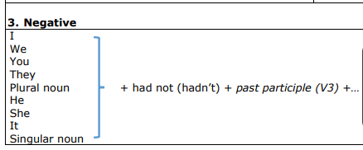
Ex: She had not watch that movie. Ex: You had not sent me your report. Ex: We had not met each other.

Slide 5
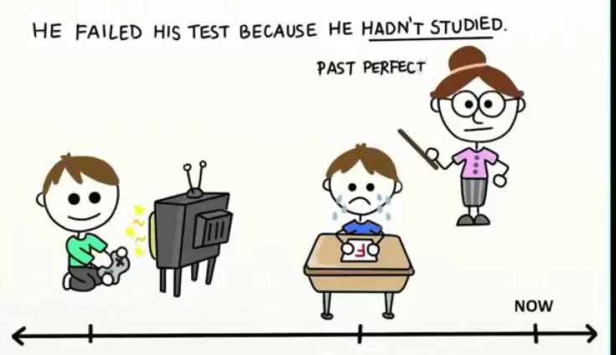
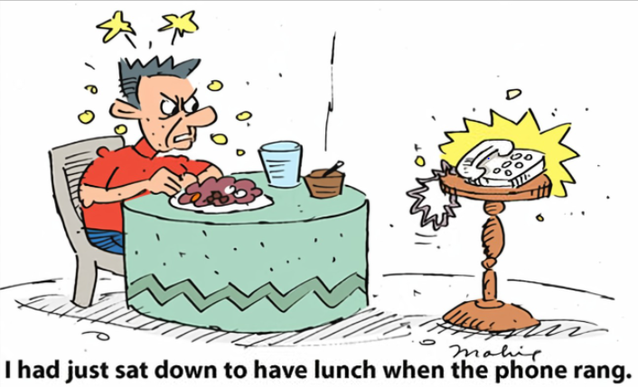
USAGE √ We use Past Perfect Simple for the action that happened before another action or time in the past. Ex: We had left school before 9:30 PM last night. Ex: She had met Dara before he left Phnom Penh

Slide 6





Thank you !
www.passerellesnumeriques.org

